Slide 1
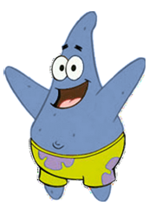
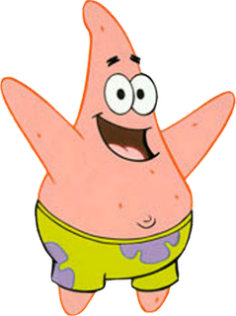
Synonyms
Words that mean exactly the same or nearly the same as another word in the same language.
Hey, you look like me…
Hey, I look like you…

Slide 2

Learning Objective/Aim
Ooh look… a synonym.
By the end of this lesson you will be able to:
Define synonym
Identify and give examples of synonyms.

Slide 3
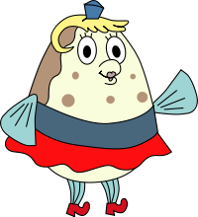
Think of synonyms for these words
Friend
Journey
House
Woman
Grandma
Floor
However
Said
Good
Bad
Small
Mate
_____
_____
_____
_____
_____
_____
_____
_____
_____
Tiny

Slide 4
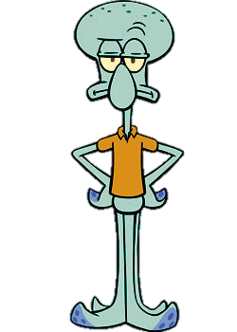
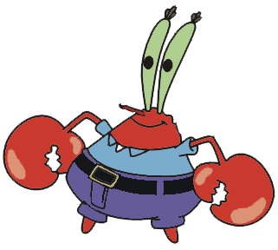
In Pairs
Think of THREE synonyms for each word below:
Excellent
Doctor
Police
Writing
Great! Teamwork!

Slide 5
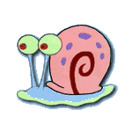
Excellent
Superb
Outstanding
Magnificent
Exceptional
Admirable
Worthy
Wonderful
Perfect
Eminent
Splendid
Fine
Supreme
First-rate
Marvellous
Ace
Terrefic
Yeah…I got those.

Slide 6
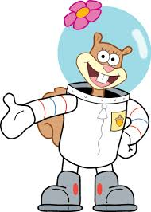
Doctor
Physician
Surgeon
Medic
Clinician
Healer
Quack
Specialist

Slide 7
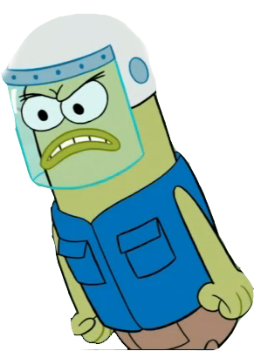
Police
Bobby
Detective
Cop
Rozzer
Blue
Officers
Fed
Some of these should not be used in formal situations…

Slide 8
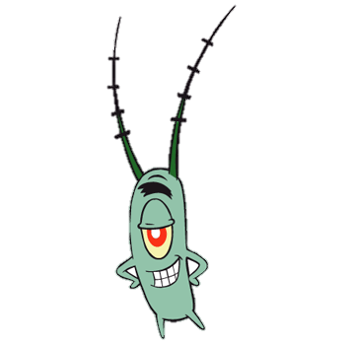
Writing
Script
Scribing
Print
Text
Chirography
Calligraphy
Scribble
Jotting

Slide 9
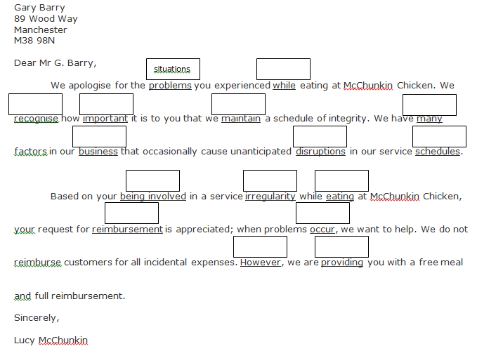
Activity (In your books)
Look at this letter below and in the boxes above write a synonym of the underlined word below.
The first one has been done for you. The letter with your synonyms must make sense.

